Slide 1
Web Page Title Scraper

Slide 2
The Team
Faiza Team leader
Kanak
Taniya Dhingiya
Alisha
Student Name

Slide 3
Workload Division
Contribution of each team member in project
Faiza = What is wed Scraping ?, Use of Web Scraping, Project File.
Taniya Dhingiya = Problem statement, Solution of the Problem statement, Presentation
Alisha = Tools & Libraries and Documentation Report
Kanak = Code for Scraping , Output, Conclusion, Presentation.

Slide 4

The Background
Extract and display the tittle of a web page using BeautifulSoup

Slide 5
Problem Statement
Problem Statement
Extract and display the title of a web page using BeautifulSoup.

Slide 6
Proposed Solution
Solution of The Problem Statement
In Python we will use BeautifulSoup Library to extract the title of any web page.

Slide 7
Web Scraping?
What is Web Scraping?
Web scraping, web harvesting, or web data extraction.
Web scraping is the process of automatically extracting information from websites.
It involves downloading web pages and extracting the relevant data from them.

Slide 8
Uses of Web Scraping
Uses of Web Scraping
Web scraping is mainly used to collect, analyze, and repurpose online data for business, research, and innovation.
It helps companies to watch competitors, follow what’s trending, and make smart choices using data.
Shopping websites 🛒 Compare prices of the same product across different sites.
Travel sites ✈️ Collect flight or hotel prices to find the cheapest option.
Job portals 💼 Gather job listings to see what skills employers want.
Social media 📱 Track what people are saying about a brand or topic.
News sites 📰 Collect headlines to stay updated on current events.
Sports websites ⚽ Get live scores or player stats quickly.

Slide 9

Tools & Libraries
Python – programming language for scripting.
Requests – Send request to fetch HTML content of web page.
BeautifulSoup (bs4) – parses HTML and extracts elements.

Slide 10
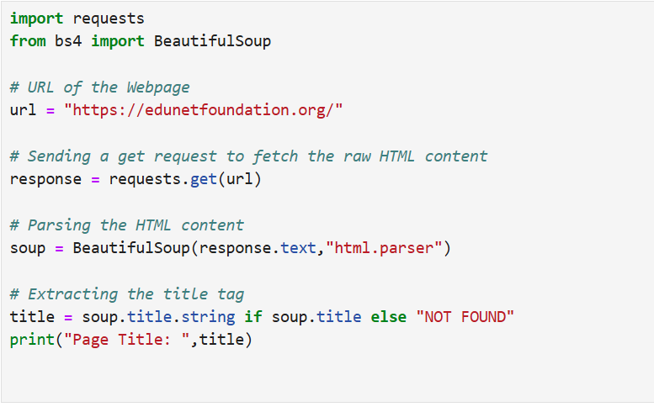
Code for Scraping

Slide 11

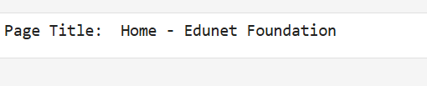
Output

Slide 12

Conclusion
BeautifulSoup makes web scraping simple and effective.
Extracting titles is a foundational step for larger scraping projects.

Slide 13
Thank You

